Slide 1
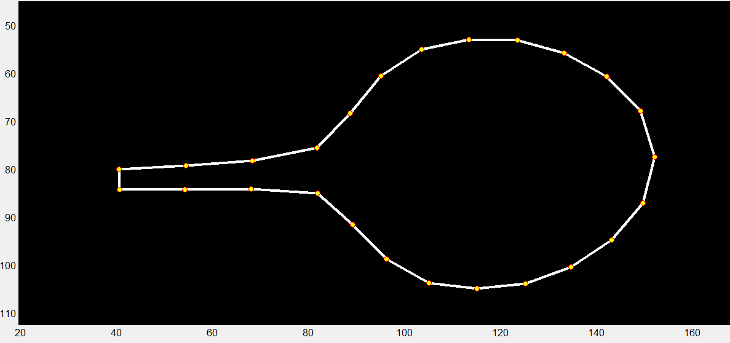
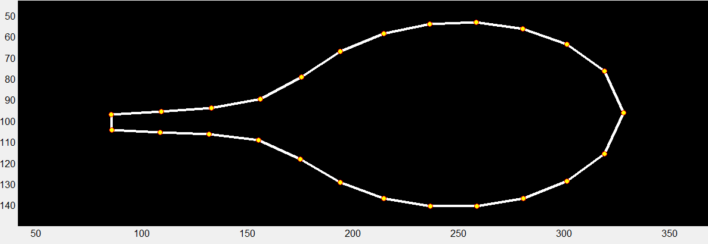
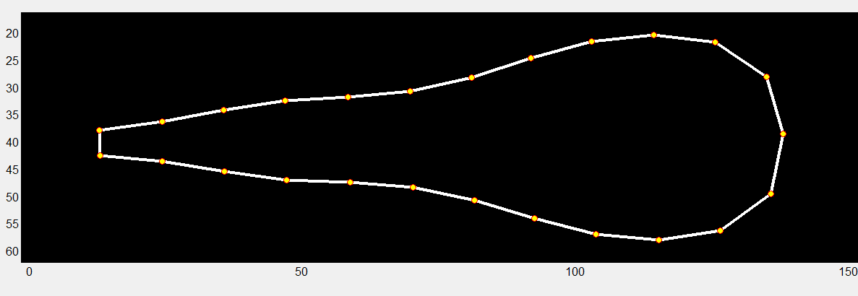
Leaf7.PC1
Leaf4.PC1
Petal.PC1
Leaf7.PC2
Petal.PC2
Leaf4.PC2
Leaf7.PC3
Figure S1. PCA was applied to the Leaf4, Leaf7, and Petal data set to identify trends in shape and size variations among MAGIC lines.
The outline of a leaf was represented by the Cartesian coordinates of its 25 points, and similarly, a petal was represented by 25 points in the same way. The GIF showed the data set for each PC expressed in standard deviation from the mean position of the point within the collection of leaves and petals.

Slide 2
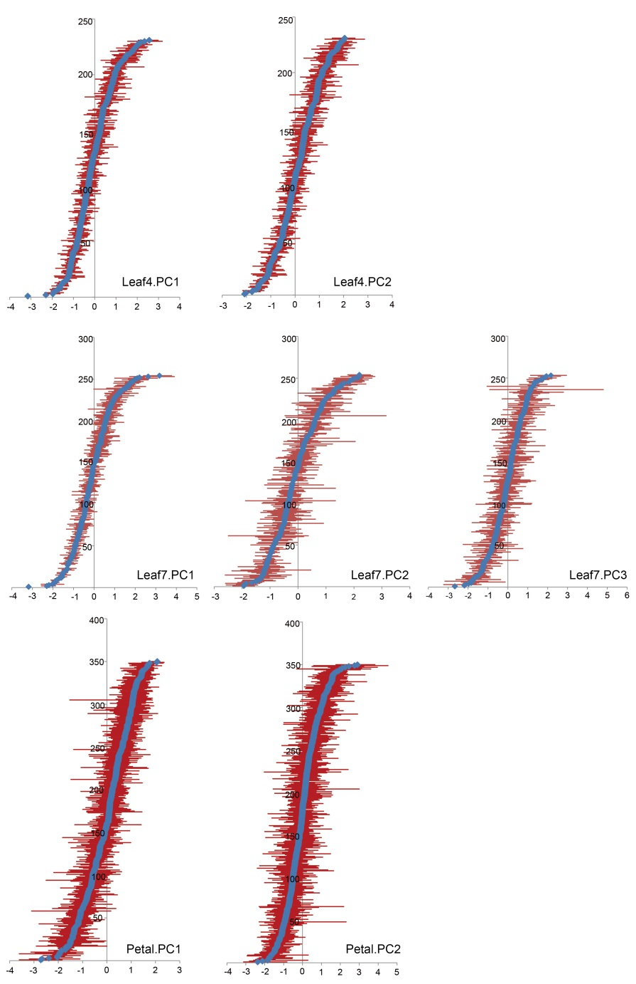
Figure S2. Range of PC values obtained for leaf and petal allometric model.
The mean of each MAGIC line is represented by a blue diamond and the bars display the range of all the values observed for this line. PC units are standard deviations.

Slide 3
Figure S3. Variation along each PC for leaf4, leaf7 and petal allometry within the MAGIC lines.
Each histogram represents the distribution of MAGIC lines along one of the PCs from the leaf and petal allometry model.

Slide 4
Figure S4. QTL scan of the PCAs for the fourth leaves allometry among MAGIC lines.
The dot represented the peak SNP site with Log P value >3.

Slide 5
Figure S5. QTL scan of the PCAs for the seventh leaves allometry among MAGIC lines.
The dot represented the peak SNP site with Log P value >3.

Slide 6
Figure S6. QTL scan of the PCAs for the petals allometry among MAGIC lines.
The dot represented the peak SNP site with Log P value >3.

Slide 7
Figure S7. QTL scan of the PCAs for the fourth leaves and petals allometry covariation among MAGIC lines.
The dot represented the peak SNP site with Log P value >3.

Slide 8
Figure S8. QTL scan of the PCAs for the seventh leaves and petals allometry covariation among MAGIC lines.
The dot represented the peak SNP site with Log P value >3.

Slide 9
Figure S9. QTL scan of the life-history traits among MAGIC lines.
The dot represented the peak SNP site with Log P value >3.

Slide 10
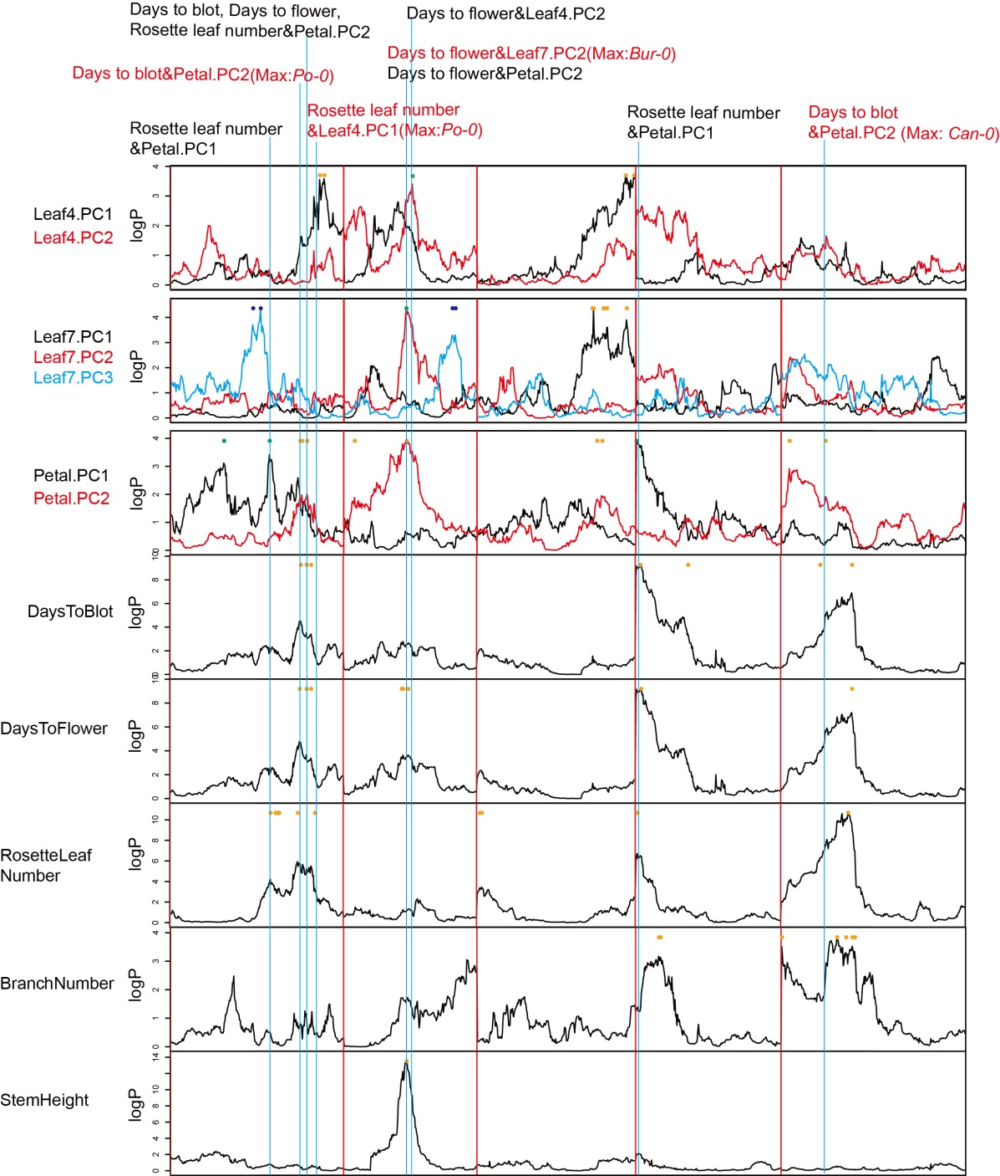
Figure S10. The genetic correlation between life-history traits and allometry model.
The vertical lines represented the QTLs overlapped with peak SNP within 1 Mb. The different QTLs with same accession allele conferring maximum affects are showed in red.

